Slide 1

Internationalization in Angular
@_clarkio
Brian Clark

Slide 2
What is Internationalization?
Building an application such that it can support various languages and regions without architectural changes.
i18n = i + 18 letters + n

Slide 3
Angular-Translate
An Angular module that provides internationalization support
Change languages on the fly
Extensible
Modular

Slide 4
Installation
bower install angular-translate --save
add the script to the index.html file
add the dependency for your Angular app

Slide 5
Demo

Slide 6
Configuration
Teach your app about a language
This is done through the $translateProvider during the config phase
Similar to configuring $locationProvider or $routeProvider

Slide 7

Translation Tables
These are created using JSON:
Translation ID
Translation Value

Slide 8
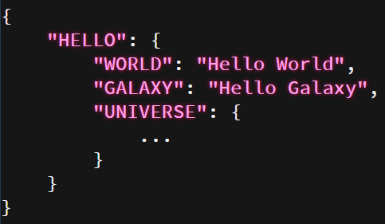
Translation Tables
These are created using JSON:

Slide 9

Configuration

Slide 10
Demo

Slide 11
Translation in Views
Translate Directive
Translate Filter
Translate Service

Slide 12
Demo

Slide 13
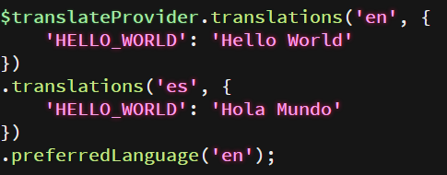
Multiple Languages

Slide 14
Demo

Slide 15

Changing Languages

Slide 16
Demo

Slide 17
Questions

Slide 18
Resources
GitHub: https://github.com/angular-translate/angular-translate
Docs: https://angular-translate.github.io/
StackOverflow: http://stackoverflow.com/a/23866441

